Slide 1
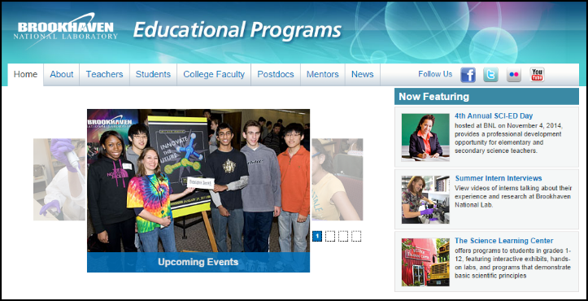
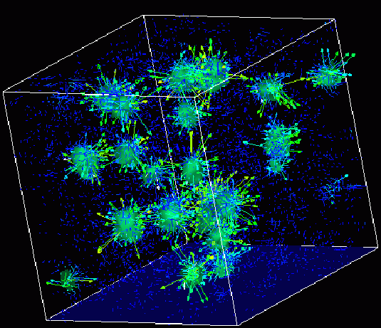
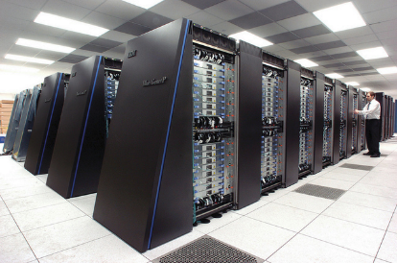
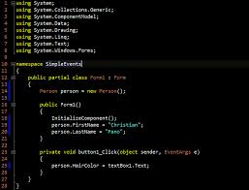
Survey of
Scientific Computing
(SciComp 301)
Dave Biersach
Brookhaven National Laboratory
dbiersach@bnl.gov
Session 05
2D Graphics,
Polar Coordinates

Slide 2
Session Goals
Learn the SimpleScreen custom class to draw graphics
Understand the World bounding rectangle
Use Cartesian coordinates to draw 2D lines
Use polar coordinates to draw 2D circles
Approximate circles by dividing $2π$ radians into intervals
Use a delay count to watch each interval being drawn
Appreciate the hidden geometry of the Olympic Rings
Draw fancy curves using parametric equations

Slide 3
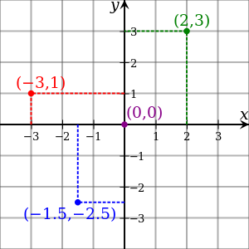
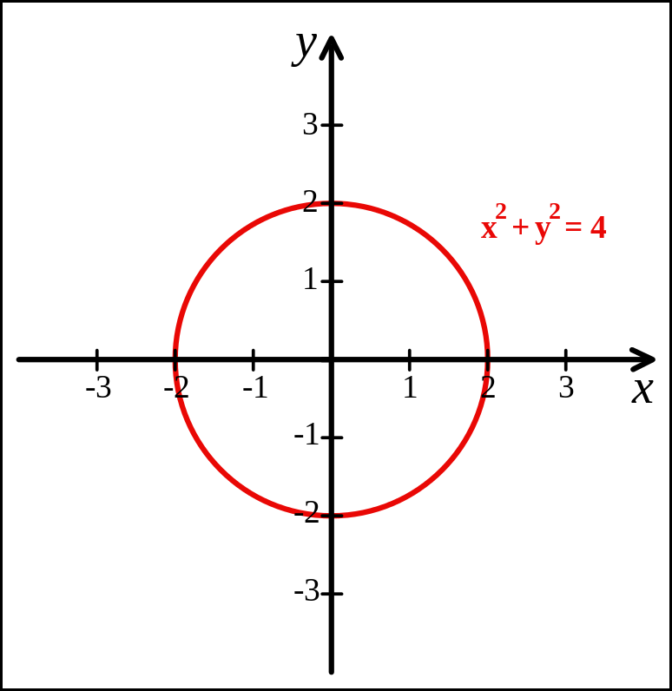
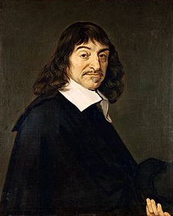
Cartesian Coordinates
Created by René Descartes in 1637

Slide 4
Screen Pixels
A computer screen is divided into 2D array of small rectangles called pixels
Every pixels has both an X and a Y coordinate
Each pixel is set to a specific color
The number of pixels in each dimension is the resolution
Modern screens have resolutions greater than 1920 x 1080
The top left screen pixel has coordinates (0,0) and there are no negative pixel coordinates
Unfortunately there is an even greater discrepancy between Cartesian coordinates and pixel coordinates…

Slide 5
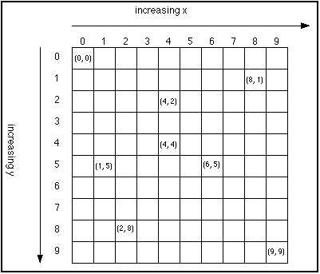
Screen Y vs. World Y Coordinates
In screen coordinates, as you move from the top of the screen towards the bottom, the Y coordinate increases!
This is the exact opposite of world (Cartesian) coordinates
Fortunately, the X axis behaves the as expected between the screen and world coordinate system
This discrepancy will drive you nuts!

Slide 6
World Bounding Rectangle
World coordinates are what we use when doing pure math
Screen coordinates are what we have to use when drawing
We need a way to map World X,Y to Screen X,Y
The world is framed by a “bounding rectangle” which is comprised of four variables of type double
worldXmin, worldYmin
worldXmax, worldYmax
The values for all four World variables are our choice – they can be as big or as small as we want them

Slide 7
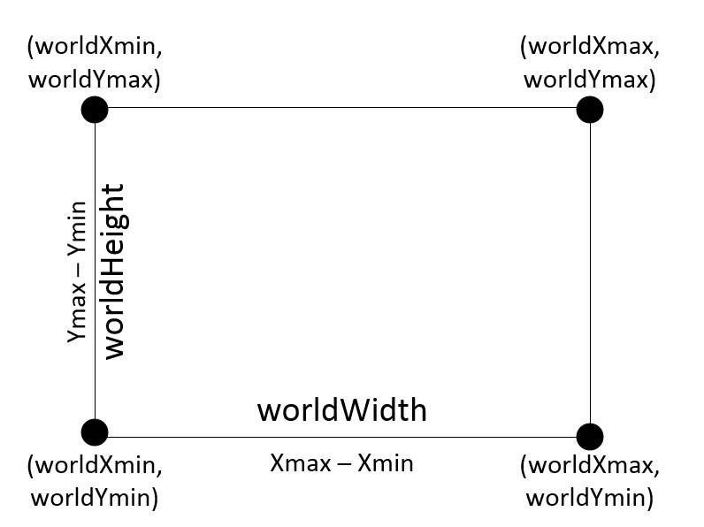

World Bounding Rectangle

Slide 8
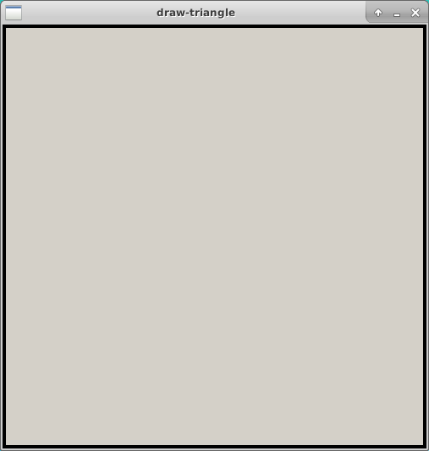
Screen Bounding Rectangle
The Screen bounding rectangle is the size of the Allegro display bitmap
Due to your smaller laptop screens, we set the size to be 501 x 501
Remember Screen Y coordinates are inverted as (0,0) is in the top left
(0, 0)
(0, 500)
(500, 500)

Slide 9
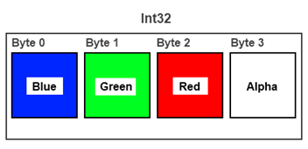

Argb Color Encoding

Slide 10
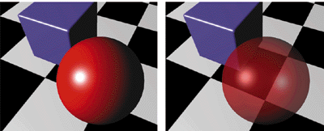
Alpha Blending = Opacity
Alpha = 0 means fully transparent (see through)
Alpha = 255 means fully opaque
We will be using Alpha = 255 in our code

Slide 11
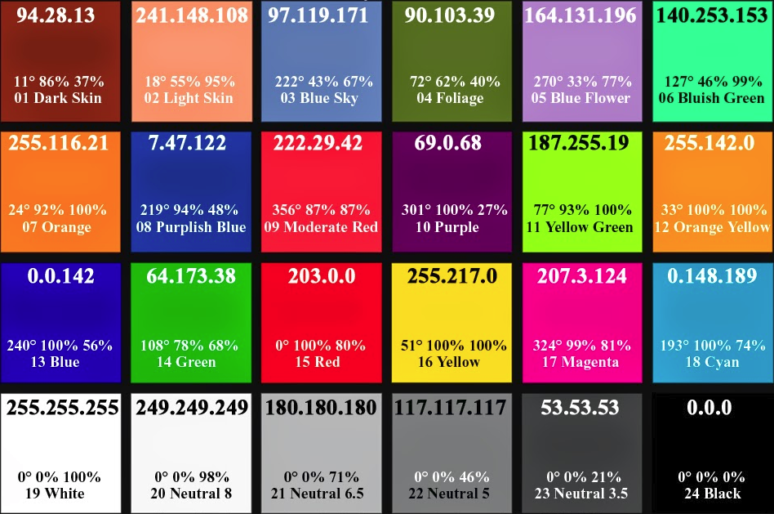
Various Colors in RGB Values

Slide 12
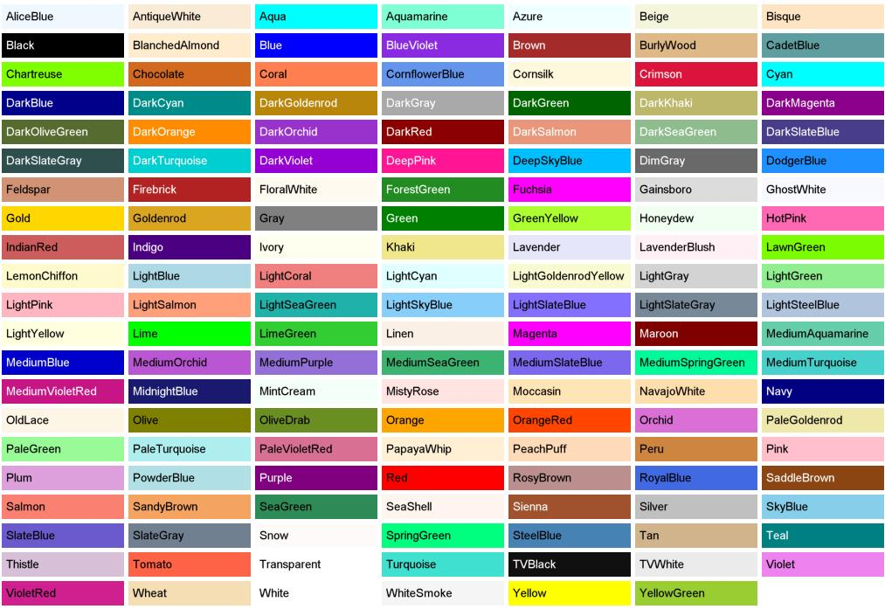
Predefined Color “Names”

Slide 13
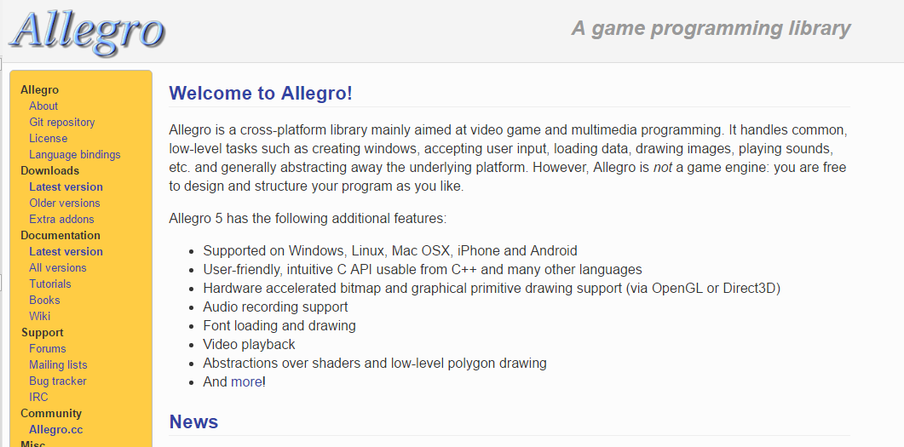
Allegro Graphics Library
http://liballeg.org

Slide 14
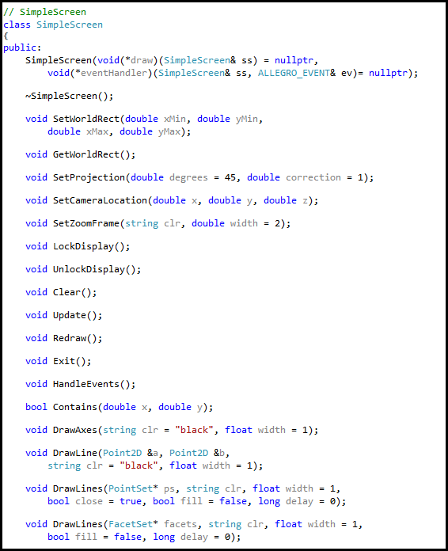
The SimpleScreen Class
Your App
SimpleScreen
Allegro

Slide 15
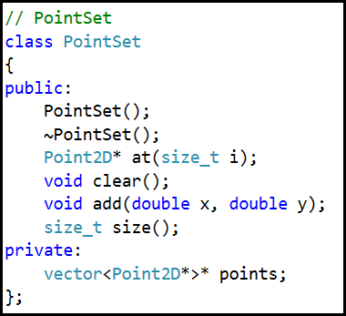
The PointSet Class

Slide 16
Open Lab 1 – Draw Triangle
No coding required – just follow along main()
Draw a 3-4-5 right triangle in the first quadrant
Paint the entire triangle RED including the interior
Set the correct world rectangle dimensions

Slide 17
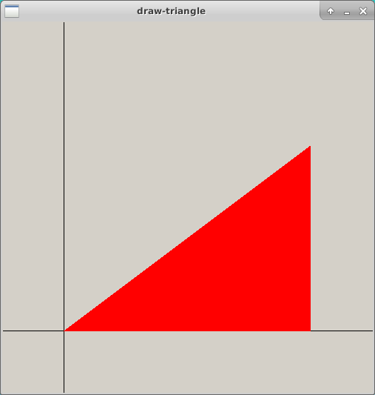
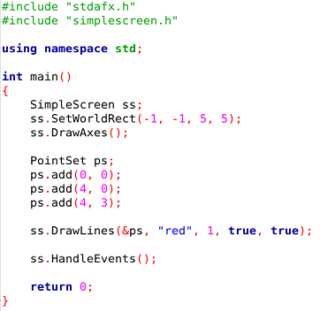
Run Lab 1 – Draw Triangle

Slide 18
Run Lab 1 – Draw Triangle
(4, 3)
(0, 0)
(4, 0)

Slide 19
Run Lab 1 – Draw Triangle

Slide 20
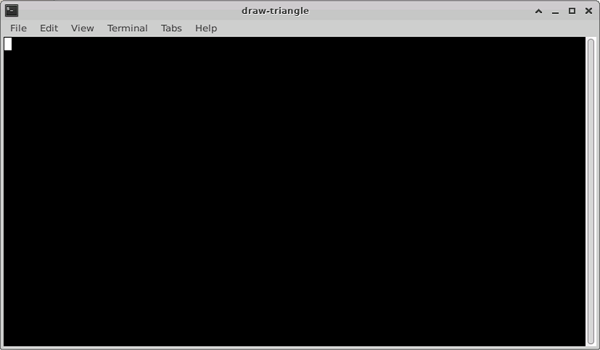
Run Lab 1 – Draw Triangle
To stop an Allegro app, close the backing terminal session FIRST

Slide 21
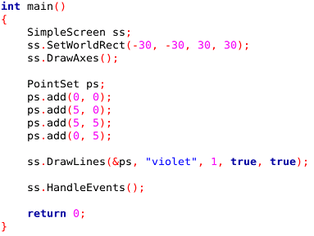
Open Lab 2 – Draw Rectangle
Draw a violet rectangle in the first quadrant
The dimensions are: Area = 210 and Perimeter = 62
Assume the world coordinates are (-30,-30) to (30,30)

Slide 22
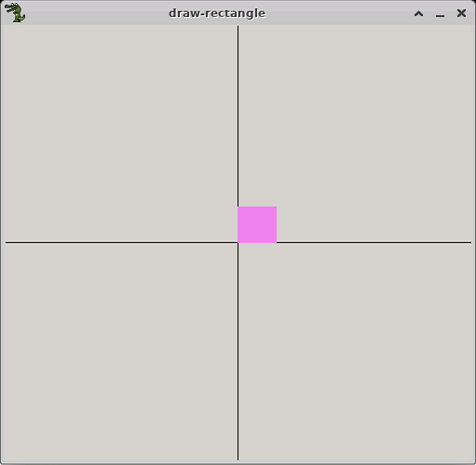
Run Lab 2 – Draw Rectangle
Draw a violet rectangle in the first quadrant
The dimensions are: Area = 210 and Perimeter = 62
Assume the world coordinates are (-30,-30) to (30,30)
(5, 5)
This output is not what your scientist requested from you

Slide 23

Edit Lab 2 – Draw Rectangle
Draw a violet rectangle in the first quadrant
The dimensions are: Area = 210 and Perimeter = 62
Assume the world coordinates are (-30,-30) to (30,30)
Edit the coordinates of the three remaining corner points with the correct values
Fix these last 3 points

Slide 24
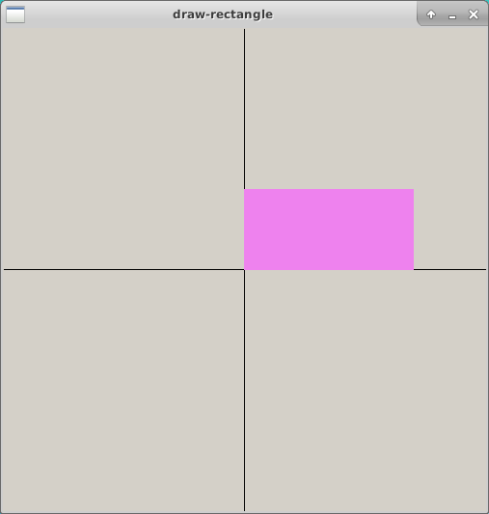

Check Lab 2 – Draw Rectangle
(21, 10)

Slide 25
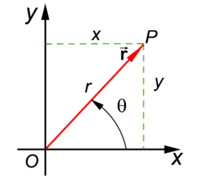
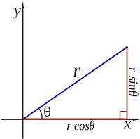
Polar Coordinates
A radius and an angle (theta)
make a 2D polar coordinate
$$(r∗\cos{θ, r ∗ \sin{θ)}}$$

Slide 26
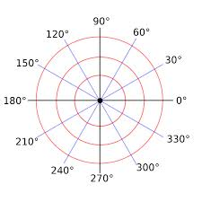
Polar Coordinates

Slide 27
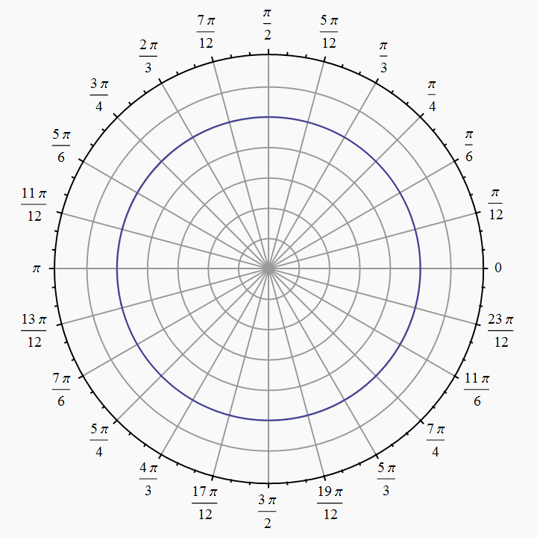
Polar Coordinates
Angles are measured in
radians
(0 ≤ θ ≤ $2π)$

Slide 28
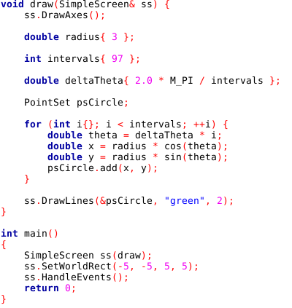
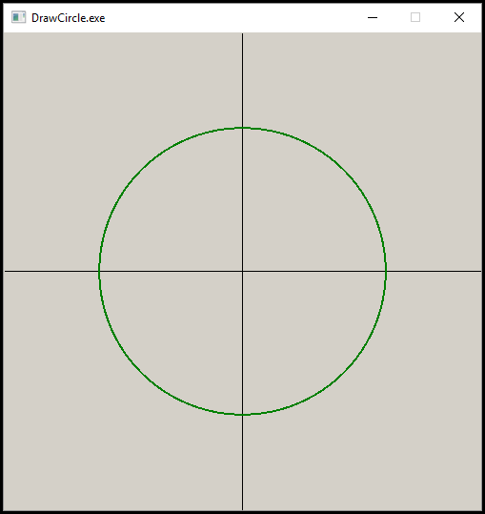
Open Lab 3 – Draw Circle
draw() is a “callback function” It is your custom drawing code that is called by the SimpleScreen object

Slide 29
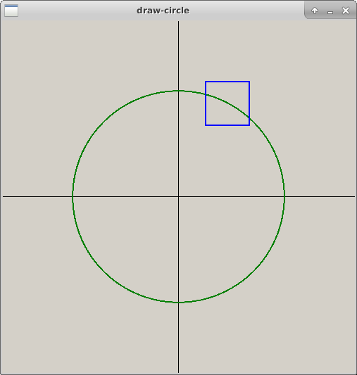
Run Lab 3 – Draw Circle
By using the callback pattern, the framework can call your custom draw() function whenever it needs to repaint the screen. This enables features like zooming
You can left click and drag on the canvas to outline a zoom frame. When you release the left mouse button it will set the new world rectangle to the coordinates of the zoom frame and redraw the image
A single right click will restore each of the prior zoom levels

Slide 30

Edit Lab 3 – Draw Circle
First, change intervals to 8, run the app, then leave it at 8 for the next steps – what shape do you see?
Then change call to ss.DrawLines() as follows, and run the app each time after making these individual changes:
ss.DrawLines(psCircle, "blue", 2, false);
ss.DrawLines(psCircle, "red", 2, true, true);

Slide 31
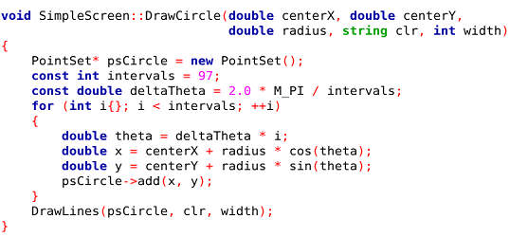
Creating a New Primitive

Slide 32

Drawing the Olympic Rings
ringOffsetFullX
(0,0)
ringOffsetY
ringOffsetHalfX

Slide 33
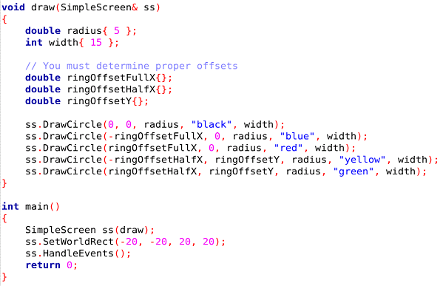
Open Lab 4 – Draw the Olympic Rings

Slide 34
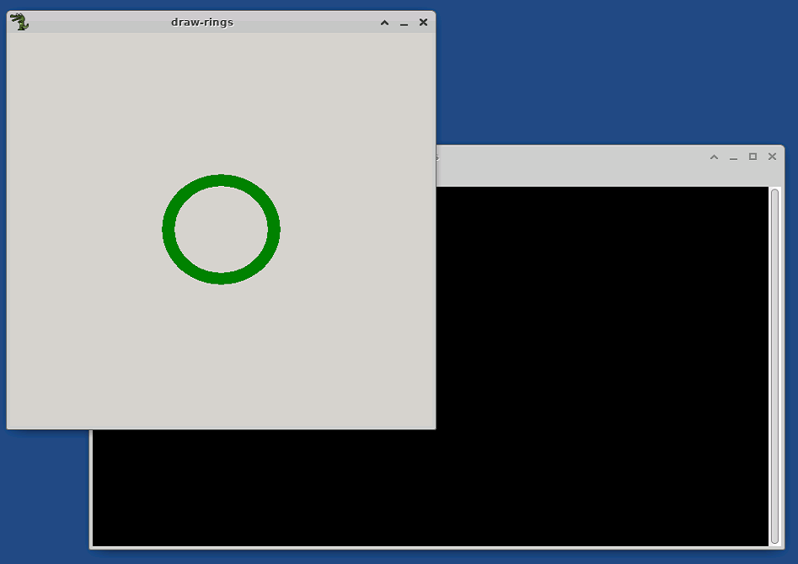
Run Lab 4 – Draw the Olympic Rings
To stop an Allegro app, close the backing terminal session FIRST
Where did all the other rings go?

Slide 35
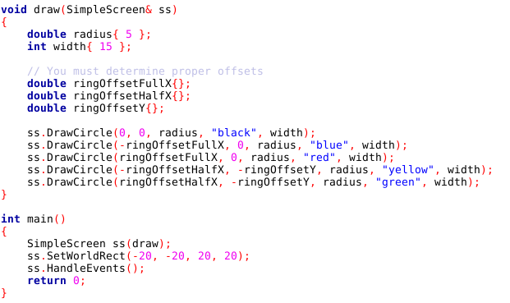
Edit Lab 4 – Draw the Olympic Rings

Slide 36
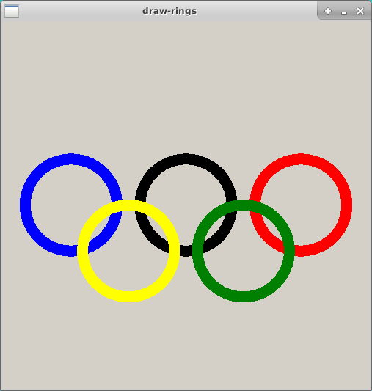

Check Lab 4 – Draw the Olympic Rings

Slide 37
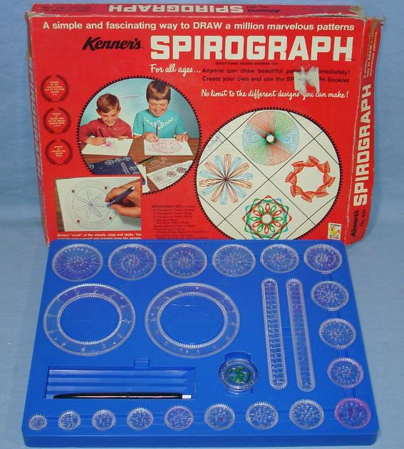
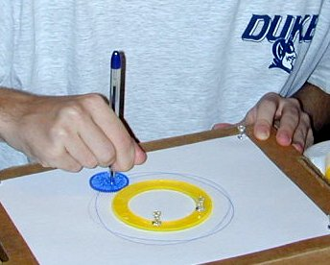
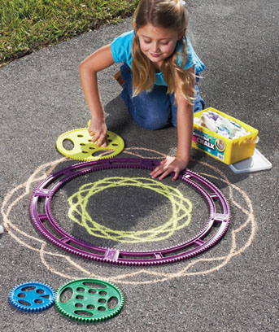
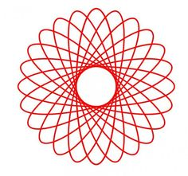
Parametric Curves

Slide 38
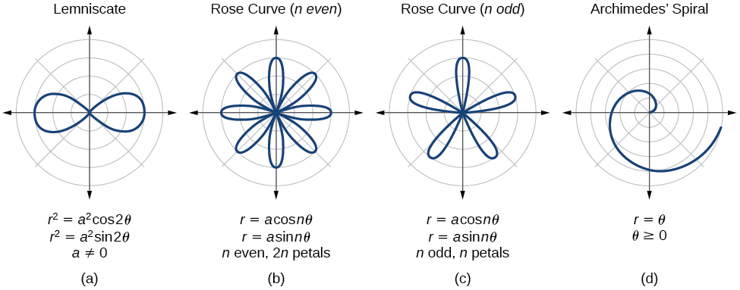
Parametric Curves
The two parameters a, n are used to calculate the current radius $r$ as $θ$sweeps the circle

Slide 39
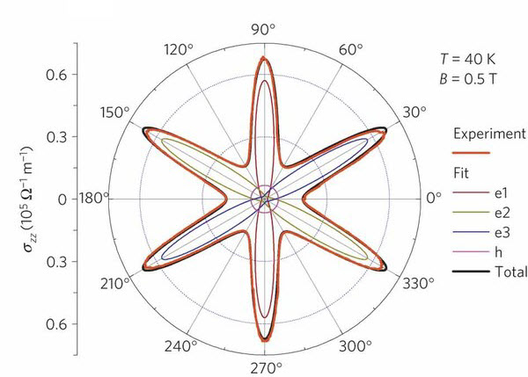
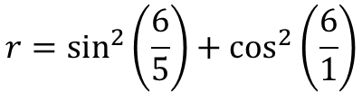
Parametric Curves
Field Induced Polarization of Dirac Valleys in Bismuth*
$$r=\sin^{2}\left(\frac{6}{5}\right)+\cos^{2}\left(\frac{6}{1}\right)$$
*Bismuth is the element with the highest atomic mass that is stable

Slide 40
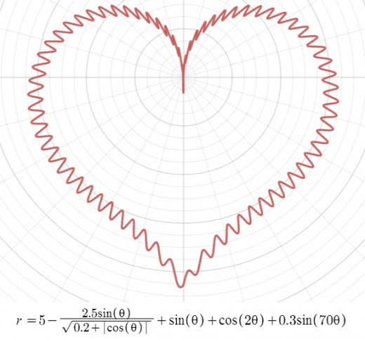
Parametric Curves

Slide 41
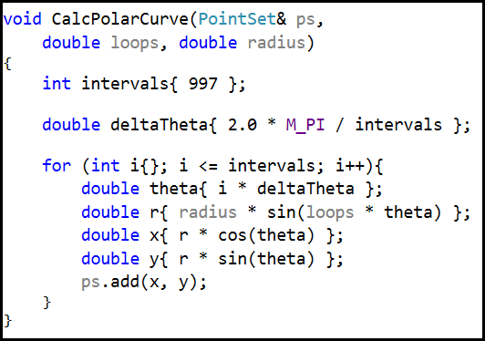
Parametric Curves
These two parameters are used to calculate the current radius $r$ as $θ$sweeps the circle
Open and run Lab 5

Slide 42
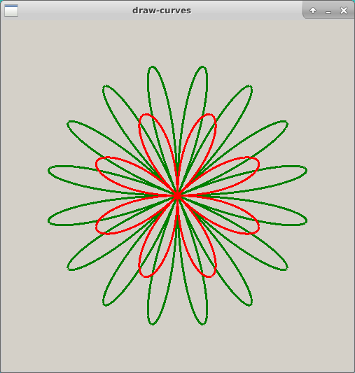
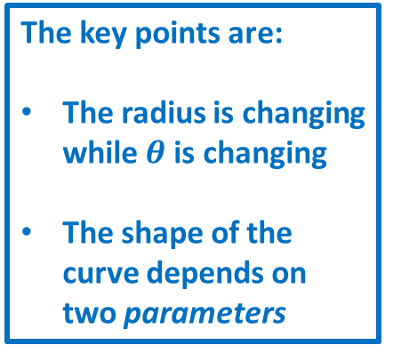
Check Lab 5 - Parametric Curves
The key points are:
The radius is changing while $θ$is changing
The shape of the curve depends on two parameters

Slide 43
Now you know…
Allegro is a free, open source, cross platform library for rendering 2D graphics
A “bounding rectangle” is used to scale world (virtual) coordinates to screen (physical) coordinates
How to create and populate elements of a PointSet
How to “connect the dots” using SimpleScreen.DrawLines()
How to use polar coordinates to draw 2D circles
We approximate circles by drawing small intervals
We can draw fancy curves by using parametric equations

